Slide 1
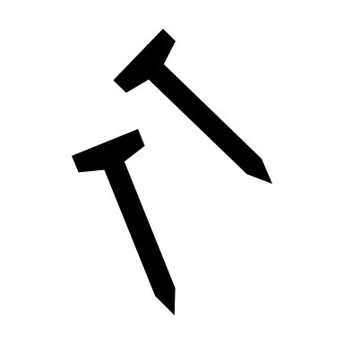

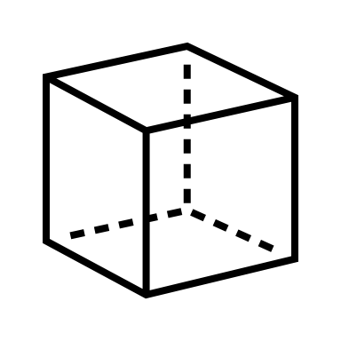


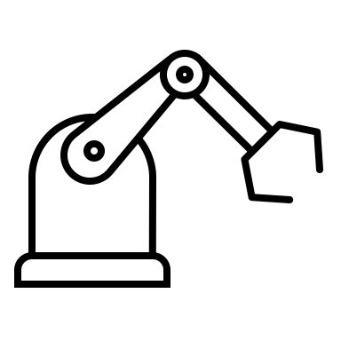

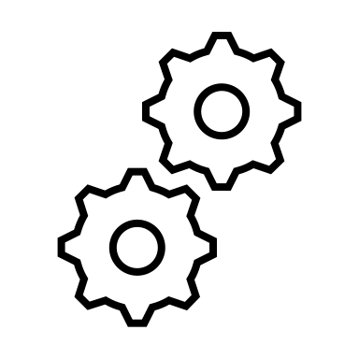
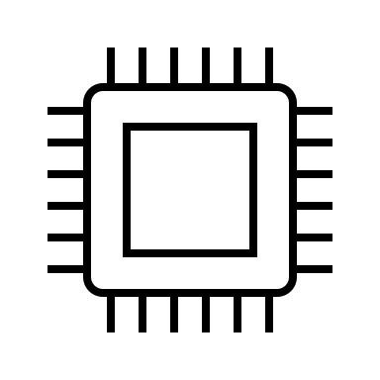

IDP: Final Presentation
Team 4 (L104) aka “Porous a drink”
Jan Derlatka (Leader, Info)
Jenny Hardwick (Mech)
Noah Barker (Elec)
Maya Roy Prabhakaran (Mech)
Lucca Pereira Martins (Info)
Szymon Piatek (Elec)

Slide 2
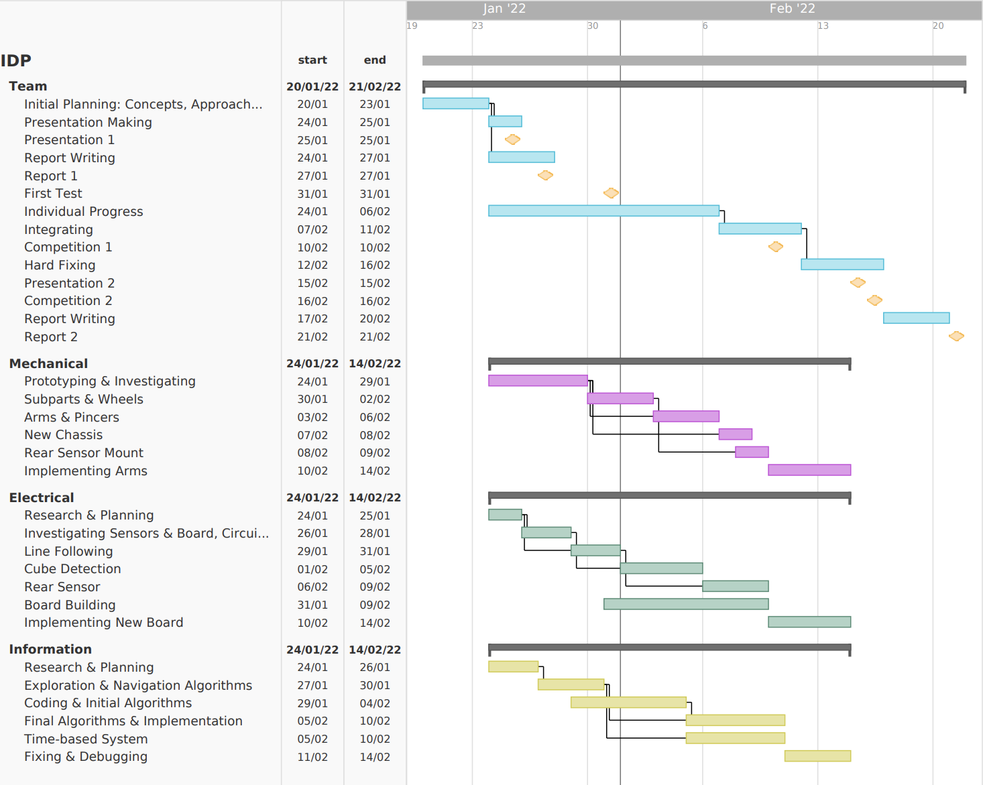
Project Management
what would you do differently if you do it again
Gantt chart :
Kept track of deadlines and expected milestones, initial chart altered throughout
Accurate time estimation although integration of new parts took longer than expected
Management:
Minimal conflict between teams ie. waiting for parts or both needing robot
Adjustment time/small changes are frequent and hard to account for
Investigation of different methods and techniques took longer than expected
GitHub Repository:
Centralized location to share and store files across teams
Version control for all teams, although primarily software, improves coordination

Slide 3
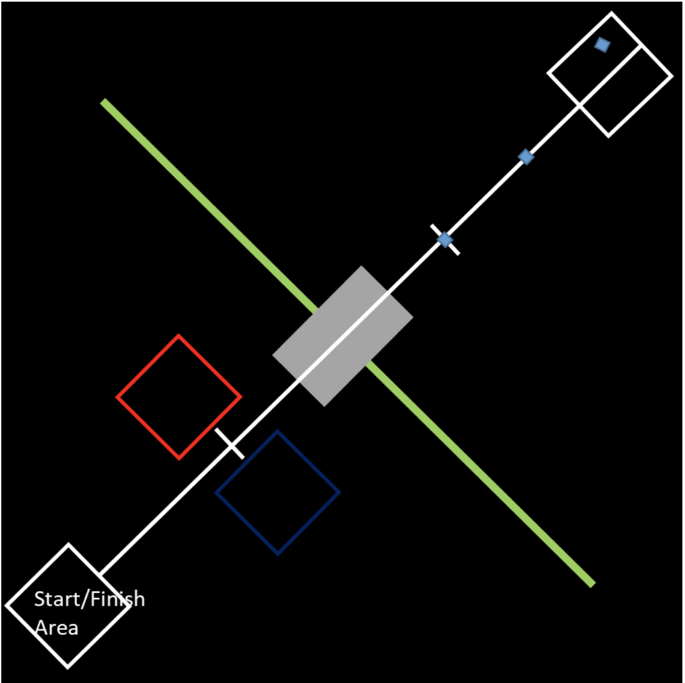
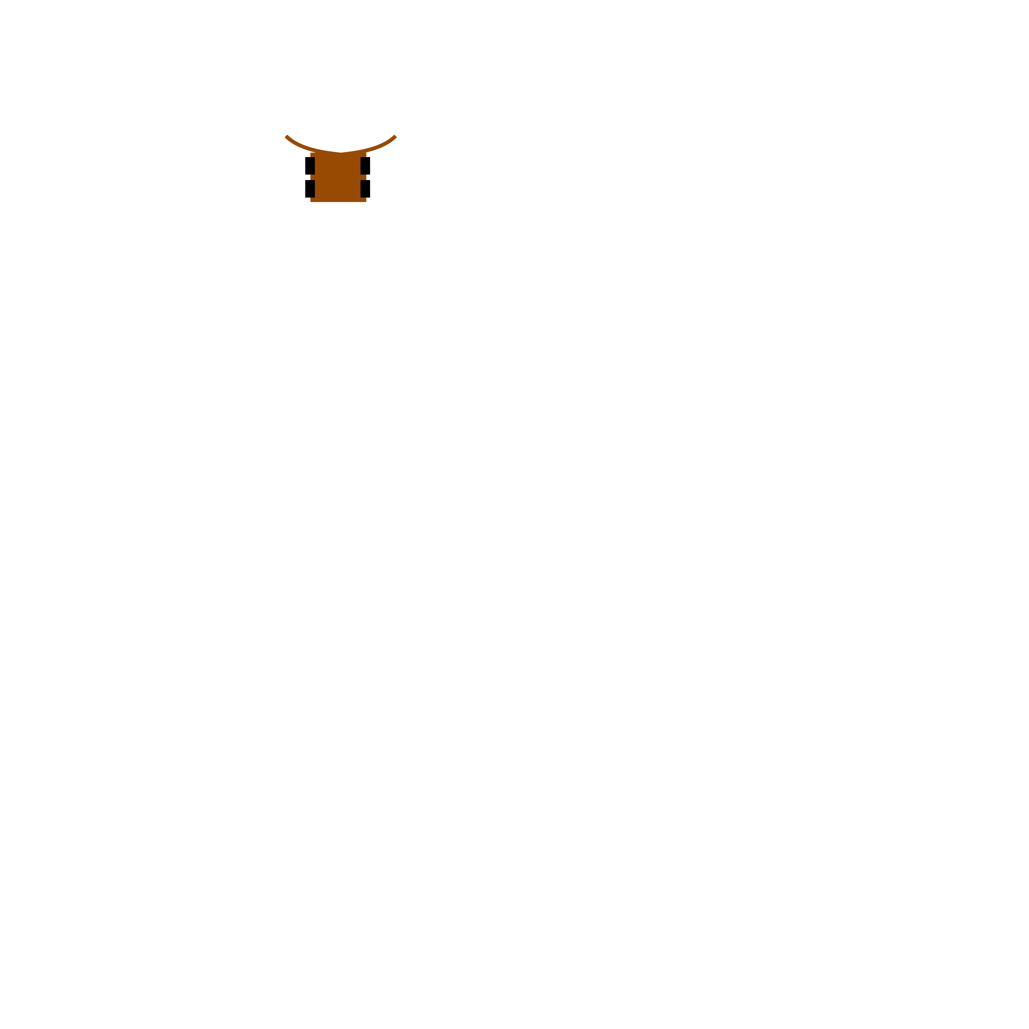
Our approach
Follow line for a given time dependent on cube number
Close arms around cube and determine cube type using infrared sensors
Rotate robot on the spot and drive back over ramp with arms open, pushing cube along
Steer cube into appropriate box, return to first intersection and repeat for next cubes, changing values for time
Innovation:
General, works for all approach removes the need for cube detection, reducing the chances of error
Relatively small and compact makes it easily adaptable to different obstacles
Sweeping arms increases task flexibility, such as heavier or different shaped objects

Slide 4
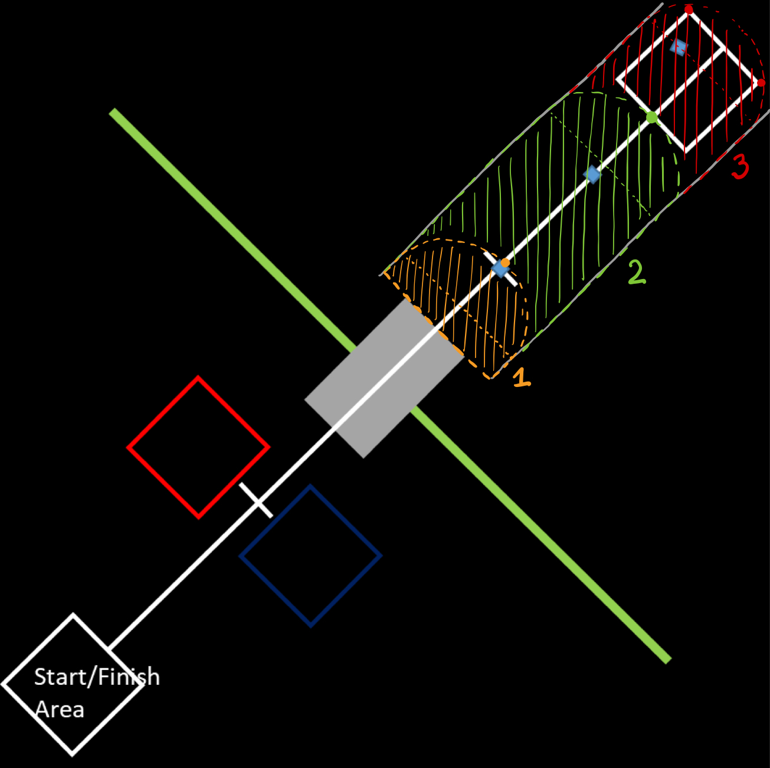
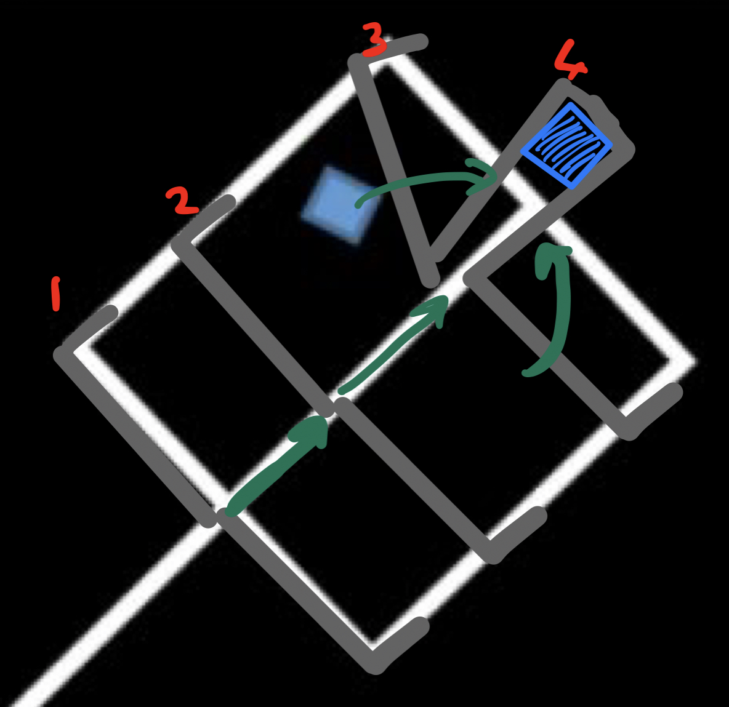
OVERALL DESIGN STRATEGY
Collecting & Transporting Cube
Identifying Cube
Robot collects cube at edge of arms where there’s an infrared sensor
Receiver outputs an analogue signal depending on voltage measurement which relates to cube porosity
Shines correct LED whilst transporting
3 sections to sweep, corresponding to each cube and accounting for all possible locations
Arms close around cube, don’t squeeze
Robot rotates 180 degrees with closed arms
fig1
Following the Line
Robot opens arms and crosses ramp
Steers into box and reverses back to intersection, triggering new time-based function to collect next cube
2 line following sensors at the front, either side of the central line
Robot will rotate on the spot and re-find line after turning
Line following turned off when depositing the cubes into the boxes, done with coding
fig2

Slide 5
PROBLEMS ENCOUNTERED & SOLUTIONS
Time based distance measurement:
How will the robot know how far to go?
How can we keep track of the robot’s current position?
Obtain an average value for velocity on flats and rotation speed through manual experiments, and using the program run time we can keep track of distance covered.
Reducing inaccuracy of a time-based measurement
Calibrate time at common intervals such as crossing intersections or reaching bottom of the ramp
Returning to the start box:
How will it know when to return?
Using the idea of resetting/calibrating the time at common intervals, we can send the robot back once it delivers the final cube and reverses out of the box
How can we ensure it returns entirely into the start box?
Trial and error to find a value of time which returns it entirely into the box
Crossing the ramp with arms:
The arms are dragging against the ramp, will this stop the robot from crossing or affect the speed?
Rotate the robot before crossing the ramp, driving forwards with open arms so they don’t drag
How can we make sure it doesn’t lose the cube?
Put a plate at the front of the robot to help it push cube and ensure height of arms prevents it from going under
Reversing line following:
Can we reverse over the ramp while holding the cube?
Can we follow the line in reverse?
Using similar mechanics to going forward, we can easily detect the line in reverse and generate enough torque to cross the ramp
How can we adjust the angle correction of the robot?
There is no way of decreasing the angle correction since we are using a rear-axel robot, unless axel moved to middle

Slide 6
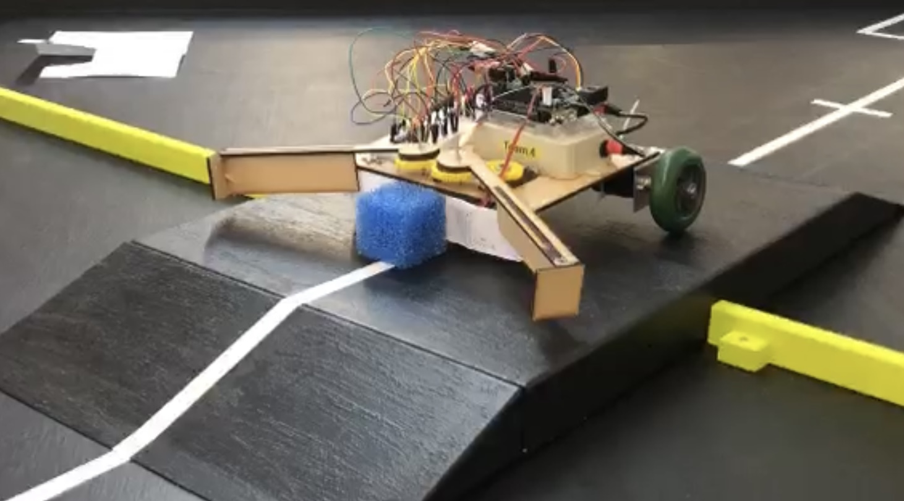
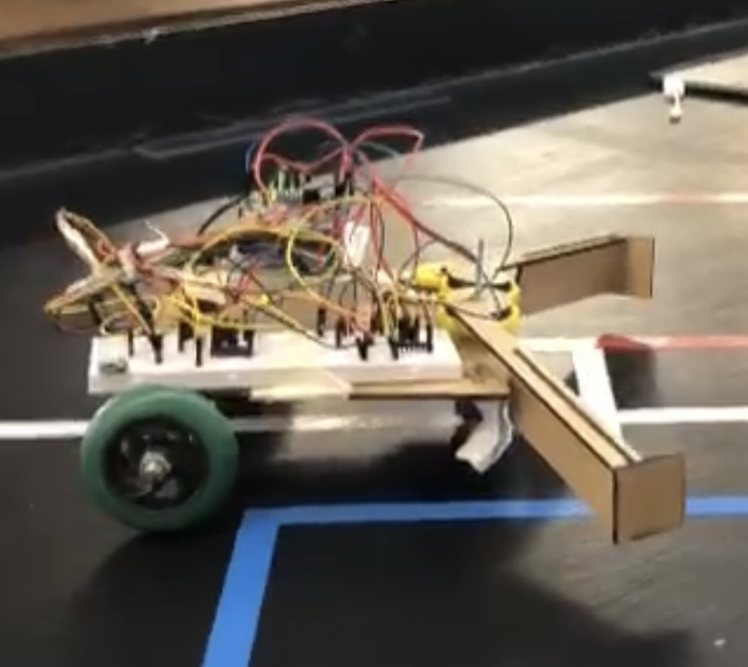
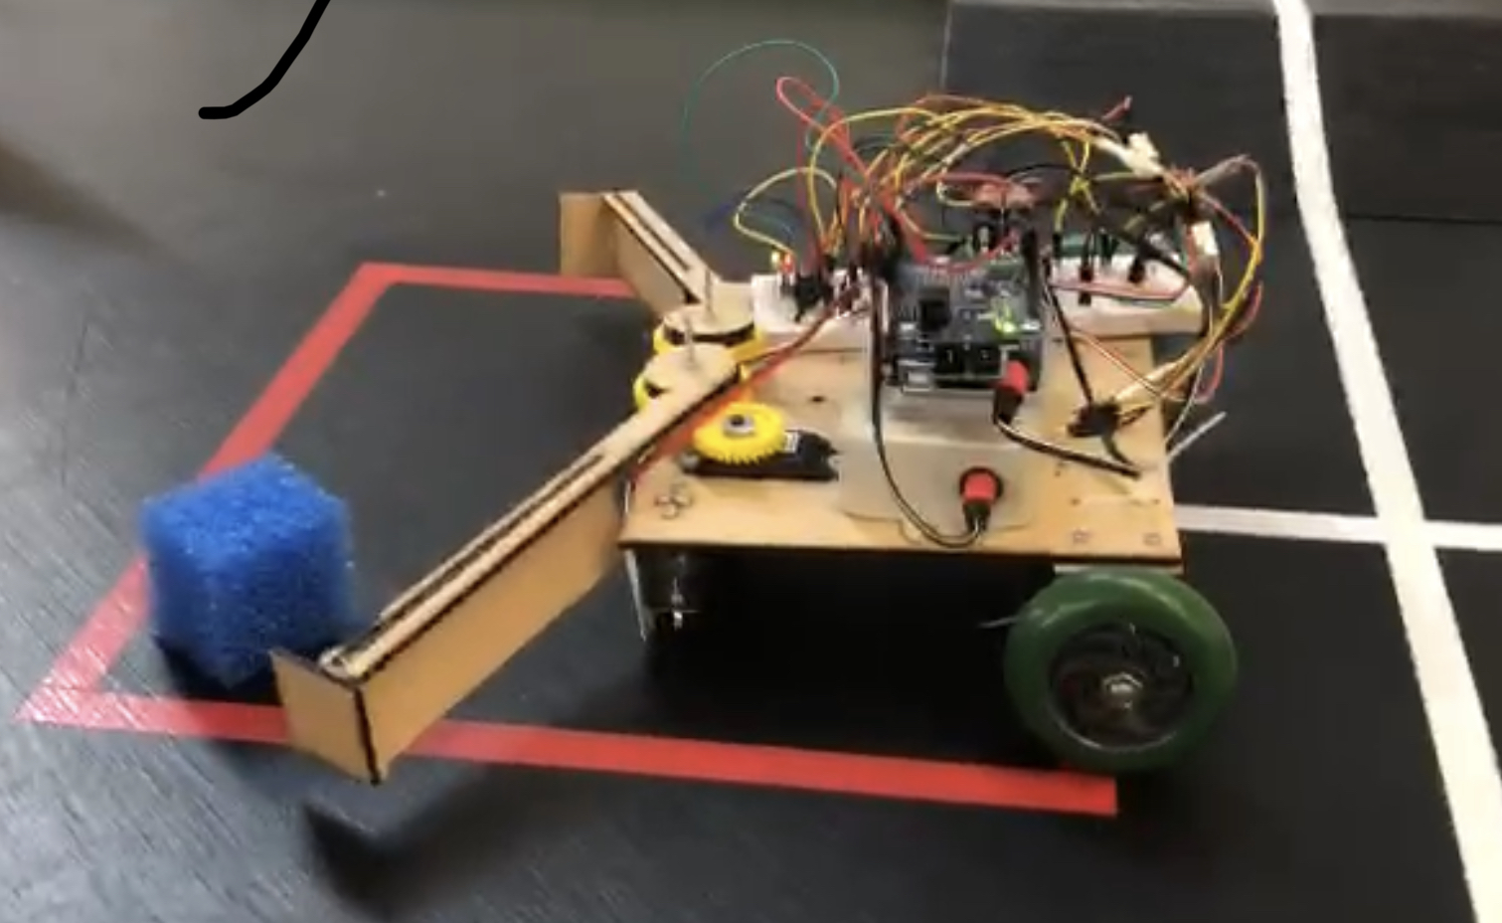
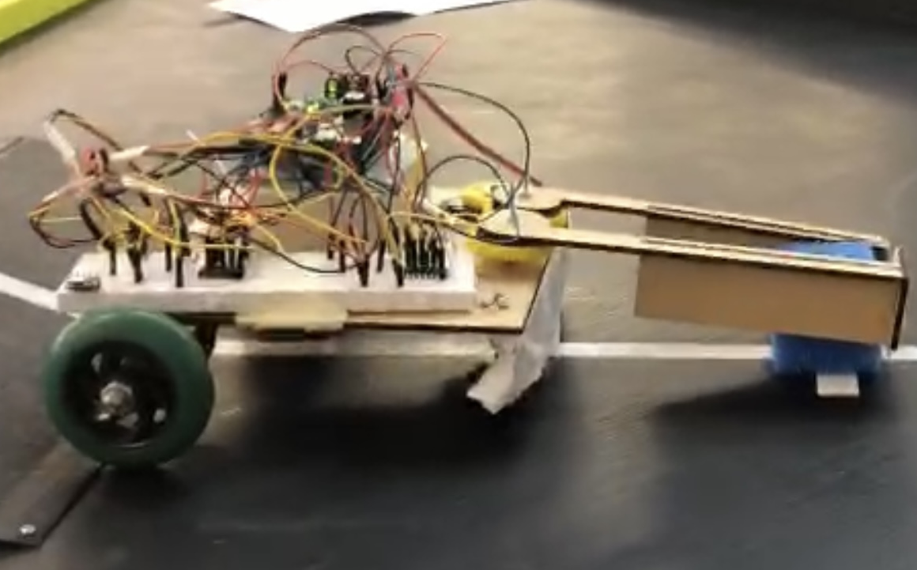
Review & Expectations
Achieved in 1st Competition:
Robot reaches alternate diagonal
Flashing LED while moving
Block transported to other side of table (Only first cube)
Block delivered to an area (Cube determining not implemented yet)
Robot returns entirely to start area
Achievable in 2nd Competition:
Transport 2nd and 3rd blocks
Cube detection and flashing correct LED
Deliver cube to correct area
General robot modifications (no sharp edges, modular construction etc.)

Slide 7
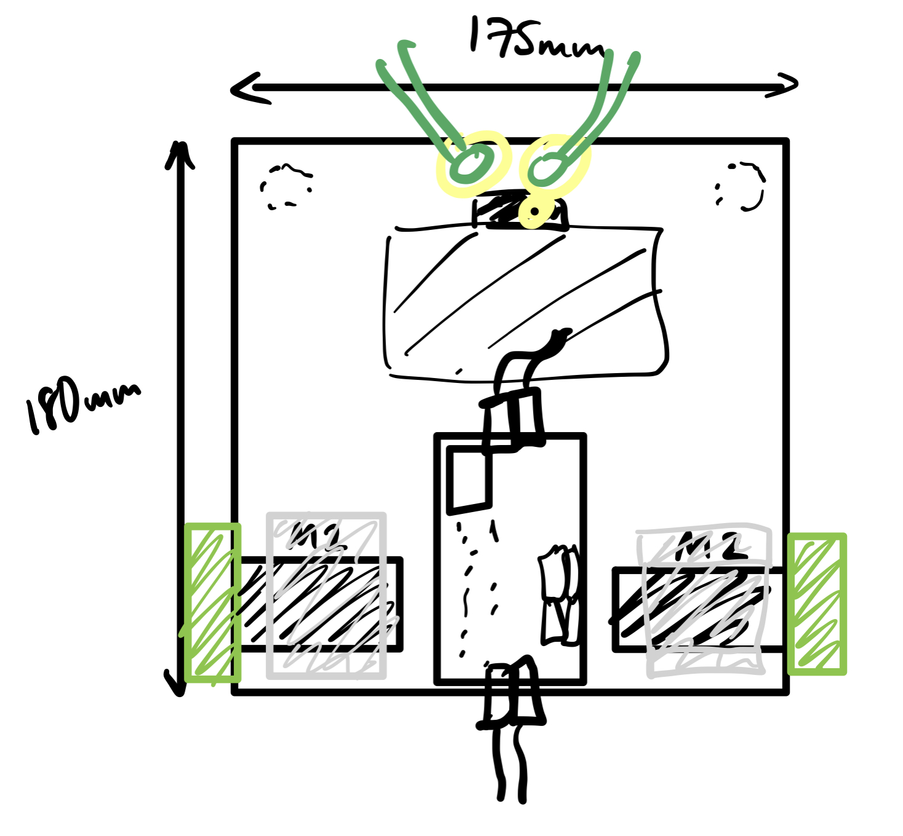
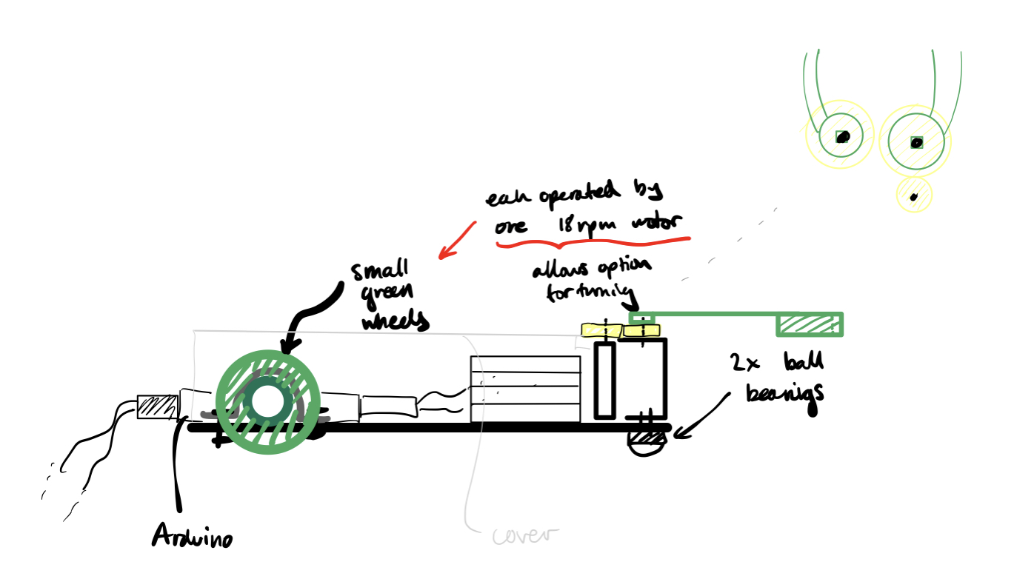
Final Design & Changes
MDF chassis + shelving
Aluminium motor mounts
3D-printed pincer arms
3D-printed servo mount
Infrared sensors mounted in corner of arm where cube sits
Discarded Ideas:
Hinged arms to cross ramp closed
Central axle and 4 ball bearings
Squeezing of cube to determine porosity and also carry it

